Slide 1
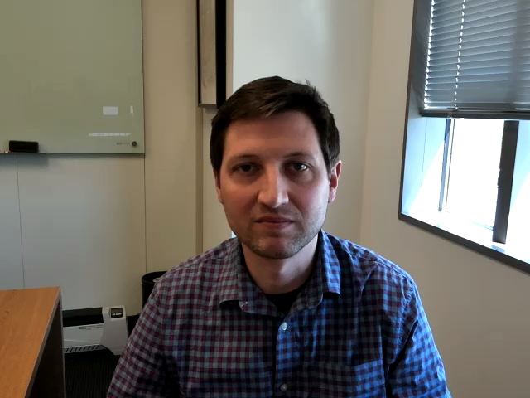
Leveraging Unstructured Data for EHR-based Prediction
Matt Engelhard
Notes:
Hi Everyone -- I’m Matt Engelhard from the Division of Translational Biomedical Informatics within the Biostatistics & Bioinformatics Department
In this lecture, we’re going to take a look at the dark underbelly of EHR data – the unstructured data
Although these data can be more difficult to work with compared to structured data, they’re also rich in clinically relevant information you won’t find elsewhere in the EHR
So, we want to make sure we know how to take advantage of them and incorporate them in our prediction models. Let's get started.

Slide 2

Lecture Outline
What is unstructured data?
Why would we want to use unstructured data?
How do we use unstructured data (in isolation) to make predictions?
How do we use unstructured data and structured data together to make predictions?
Notes:
we'll begin by defining unstructured data, contrasting them with structured data, and seeing a few examples
then, digging deeper into examples of unstructured data -- clinical notes, images, and so on -- we'll start to see why learning from these data is so important. For those of you who aren't clinicians, I hope this will start to make these data a little more concrete and intuitive
Hopefully by this point I'll have convinced you that including these data in predictive models is a good idea, and so we'll start thinking about how we do that
First, we'll look at models that use JUST unstructured data -- models that make predictions just from notes, or just from images
And then, finally, we'll see how we can combine unstructured data with structured data in our predictive models

Slide 3
What is unstructured data?

Slide 4
Structured Data
Definition: data organized into specific, queryable fields as part of an overarching model, with each field having a defined purpose.
typically stored in tabular (i.e. table, spreadsheet) format
numeric variables, categorical variables and/or short free text
Examples: demographics, diagnoses, procedures, labs, meds, vitals
Notes:
and to define UNstructured data, we first need to define structured data
Structured data is...
these data are usually stored in a table, maybe as part of an overarching data model, or in a spreadsheet, say as a csv file
they're comprised of columns of distinct variables, which are usually going to be numeric or categorical, and you might have some text fields here and there
if somebody said they're we're going to hand you a dataset from their clinical study, this is what you'd expect to get
and in the EHR, this is all the stuff you'd pull out of a system like DEDUCE here at duke -- a table of demographics, a table of diagnoses, and so on

Slide 5
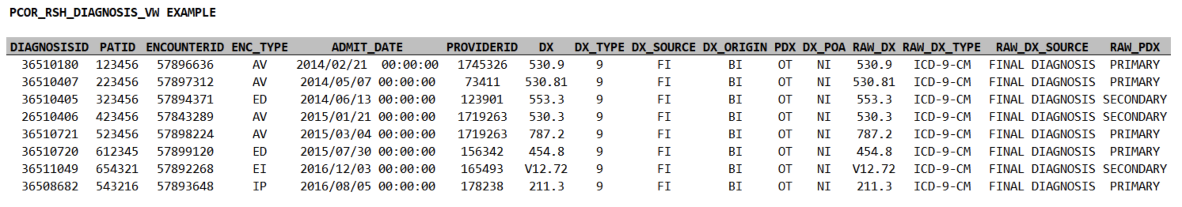
Example from Duke’s Clinical Research Datamart…
COLUMN | DEFINITION
DIAGNOSISID: | An arbitrary identifier for each record. Not currently useful for linkage across tables.
ENCOUNTERID: | The ENCOUNTERID (encounter ID) is an arbitrary identifier for a specific encounter that can be used to link information across tables in the model.
PATID: | The PATID (patient identifier) is an arbitrary, person-level identifier used to link information across tables within the data model. There is a table within the CRDM that allows an investigator with an appropriate IRB protocol to link PATID to MRN.
ENC_TYPE: | Encounter type indicates the setting in which the encounter took place (the same data are provided in the encounter table: AV=Ambulatory Visit, ED=Emergency Department, EI=Emergency Department Admit to Inpatient Hospital Stay, IP=Inpatient Hospital Stay, OS=Observation Stay, NI=No information, UN=Unknown, OT=Other
ADMIT_DATE: | The date on which the encounter began (also included in the encounter table).
PROVIDERID: | Unique identifier for a provider ? can be used to link an encounter to the provider table.
DX: | The diagnosis code; uses either ICD-9 or ICD-10
DX_TYPE: | 09=ICD-9-CM, 10=ICD-10-CM, 11=ICD-11-CM, SM=SNOMED CT, NI=No information, UN=Unknown, OT=Other
DX_SOURCE: | The approximate period within the encounter when the diagnosis was made for the patient; diagnoses are always ?Final Diagnosis (FI)?, from the billing codes.
DX_ORIGIN: | The source of the diagnosis information. ?Billing (BI)? is always the source in this data model. In 2021 OD, other diagnosis types where added that are admission and encounter_diagnosis. Billing diagnosis are still the main diagnosis to use for research projects.
Notes:
Here's an example from Duke's clinical research datamart
we have rows of identifiers, some of which can be used to link this table to other tables, including the patient id
this is a table of diagnoses, so the key column is the column of diagnosis codes
and then we have additional columns of supporting details, including the date and time, and so on
importantly, associated with this table we have a key, or dictionary, which explains what we're seeing in each of the columns

Slide 6
Unstructured Data
Definition: data that is NOT structured data
in other words, everything else
typically stored in a modality-specific format
Examples:
clinical notes
imaging (e.g. radiology, ophthalmology, ultrasound, pathology)
physiologic time series (e.g. electrophysiologic studies, digital health)
Notes:
now, we needed to start with structured data, because the precise definition of unstructured data is:::
data that is NOT structured data
in other words -- everything else (it's a catch-all term)
these are your clinical notes -- of course, there are many different types
your images, which could be from radiological studies, but they could also be from pathology, or opthalmology, and many more
your electrophysiologic studies -- electrocardiograms, electroencephalograms, electromyelograms, electrowhateverograms
it includes digital health data -- we're seeing more and more efforts to incorporate this stuff in the EHR
it might even include audio data
and the list is always growing
NOT organized into specific, queryable fields as part of an overarching model
and they do NOT fit neatly into a csv file -- instead, they tend to be stored in specific, specialized formats
for images you've got your pngs and jpegs, but you've also got your DICOM files, for example
there's a huge variety here -- far too big to cover in a single lecture
and so we're going to be talking about some general principles and focusing mostly on the most common modalities, which are images and text

Slide 7
Why use unstructured data?

Slide 8
A patient presents with shortness of breath…
Presents to urgent care and is transferred to the ED
Evaluated in the ED
History of present illness
Review of medical history (including meds and allergies) + social and family hx
Physical exam and review of systems
Lab results: BMP and CBC
Imaging & other studies: CT and EKG
Admitted to the hospital
Notes:
Let’s run through a really simplified case to think about what data, both structured and unstructured, will be generated
Suppose we have a patient that goes to urgent care – they’re transferred to the emergency department because the providers at urgent care suspect a PE, or pulmonary embolism
This is a blood that forms usually in the veins in your leg, then dislodges and travels through the right heart and into the lungs, where it can go no further, so it gets stuck, blocking blood flow, damaging tissue, and so on – not good
So they transfer this person to the emergency department, where a bunch of things happen, not necessarily in the particular order I’m showing here
1, a provider is going to document the patient’s story, including all the details believed to be relevant to the current situation
This is going to include the patient’s broader medical history – other medical conditions, their medications, any allergies
As well as their social history and family history – what conditions do family members have
The provider will do a physical examination at some point, again with emphasis on the current situation, and they’ll do a review of systems – this is a head to toe review of patient covering all the different organ systems
They’re also going to get some lab results – in this case, they’ll get a basic metabolic panel, which is a very common, standard set of labs that summarizes your fluid and electrolyte status, kidney function, and blood sugar levels
And they also get a complete blood count, which gives information about the cells in your blood – both white cells and red cells
They’ll also get a CT scan of the lungs, which along with the labs will help them determine whether it’s really a pulmonary embolism versus something else, pinpoint the location, see the extent of the damage, and so on
And this is a pretty serious issue, so this patient needs to be hospitalized – the emergency department is going to go ahead and admit them to the hospital

Slide 9
What will we find in the structured data?
Encounter details (ED admission)
Labs (BMP, CBC)
Vital signs
Procedure codes (CT)
Diagnosis codes (PE)
…what won’t we find?
Notes:
Now, what parts of this fairly complicated story -- and again, this is the super simple, quick and dirty version coming from a non-clinician – which parts are going to make it into the structured data?
Well, we’ll see who the patient is -- their age, sex, race
We’ll see that they came to the emergency department, and that they were admitted from the ED
We’ll see diagnosis codes, so we SHOULD end up seeing codes related to pulmonary embolism, supposing that ends up being the issue
And we’ll see procedure codes – we’ll see that they got a CT, for example
We’ll even see the details of those labs – the exact electrolyte values, their white cell count, and so on
So, that’s a lot of information. But it is really a comprehensive summary of the encounter?
Let’s thing about what we WON’T see.

Slide 10
The H&P
written by a UNC student and publicly available:
https://www.med.unc.edu/medclerk/education/grading/history-and-physical-examination-h-p-examples/
FHIR systems SHALL support, at minimum, these eight “Common Clinical Notes”:
Consultation Note (11488-4)
Discharge Summary (18842-5)
History & Physical Note (34117-2)
Procedures Note (28570-0)
Progress Note (11506-3)
Imaging Narrative (18748-4)
Laboratory Report Narrative (11502-2)
Pathology Report Narrative (11526-1)
Notes:
To do that, let’s start by looking at patient’s story, as documented by a provider
This example I’m showing you is publicly available on the internet, in case anybody is concerned
In fact, this is a note written by a UNC medical student as an example of how to write a history and physical, which is a detailed note covering all the elements I mentioned a moment ago
It’s also one of the note types required as part of the FHIR standard.
Now, if you read through this note, what you’ll find is that it’s very information dense.
There’s a ton of detailed information here, and all of it is potentially very important
We get his pain level and a description of the nature of the pain
We get subjective elements of his experience – a ”rattling” in his chest
We see that he had pneumonia about two months ago – this context may be very important to understand
Some of this makes it into structured fields, but more of it doesn’t

Slide 11
The H&P
written by a UNC student and publicly available:
https://www.med.unc.edu/medclerk/education/grading/history-and-physical-examination-h-p-examples/
FHIR systems SHALL support, at minimum, these eight “Common Clinical Notes”:
Consultation Note (11488-4)
Discharge Summary (18842-5)
History & Physical Note (34117-2)
Procedures Note (28570-0)
Progress Note (11506-3)
Imaging Narrative (18748-4)
Laboratory Report Narrative (11502-2)
Pathology Report Narrative (11526-1)
Notes:
Continuing on, we see all those different elements I mentioned
His past medical history, medications, review of systems

Slide 12
The H&P
written by a UNC student and publicly available:
https://www.med.unc.edu/medclerk/education/grading/history-and-physical-examination-h-p-examples/
FHIR systems SHALL support, at minimum, these eight “Common Clinical Notes”:
Consultation Note (11488-4)
Discharge Summary (18842-5)
History & Physical Note (34117-2)
Procedures Note (28570-0)
Progress Note (11506-3)
Imaging Narrative (18748-4)
Laboratory Report Narrative (11502-2)
Pathology Report Narrative (11526-1)
Notes:
And finally, we get to the assessment and plan --
This is the providers putting all the pieces together, summarizing the situation, and plotting next steps
The structured data will tell us a little bit about what they ended up doing, but it won’t really tell us why.
Here we get quite a bit of insight into the details of their thought process at the time.
This is not something you’ll find in a csv file

Slide 13
Notes are a rich source of info
Notes:
Now you might think – well, this is interesting, and maybe it was very important at the time, but is it really important for the kinds of things that I want to do with the data.
And of course it depends on what you’re doing, exactly, but in general the answer it YES – it matters more than you might think
Here’s the key finding of a recent JAMIA paper focused on identifying cardiovascular diseases and procedures from EHR data
Each of these concepts was identified by chart review by clinical expert annotators
And then they train models to identify those concepts based on
(a) structured data – this is “EHR-S”
And (b) clinical notes – this is “EHR-U”
Their findings tell a pretty consistent and compelling story
Both approaches do pretty well in terms of precision – also known as positive predictive value – in other words, both models are usually right when they tell you they’ve identified one of these concepts
However, the recall – aka the sensitivity – is FAR better for the unstructured models
Very often, the structured data models miss it
And if you look through the details, they do a good job building these models
The issue is not the models themselves – it’s that the structured data very often doesn’t contain the relevant information. It’s only found in the notes.

Slide 14
A patient presents with shortness of breath…
Presents to urgent care and is transferred to the ED
Evaluated in the ED
History of present illness
Review of medical history (including meds and allergies) + social and family hx
Physical exam and review of systems
Lab results: BMP and CBC
Imaging & other studies: CT and EKG
Admitted to the hospital
Notes:
OK, so hopefully I’ve convinced you that the notes matter
What about images?
Going back to our case, we know this patient also had a CT scan

Slide 15
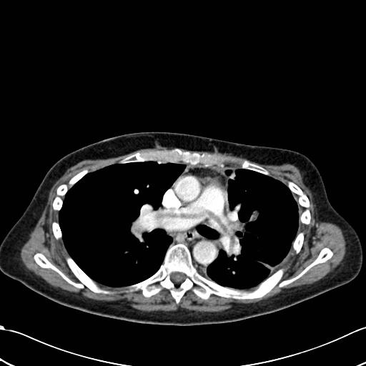
CT / Imaging
The scans / images themselves
Interpretation by radiologist (note)
Large non-occlusive pulmonary embolus draped over the bifurcation of the main pulmonary artery; a saddle pulmonary embolus.
https://radiopaedia.org/cases/pulmonary-embolism-saddle-1?lang=us
Notes:
Here’s a CT slice – this is coming from a really useful site called radiopedia – that shows a large blood clot sitting over the first branching of the main pulmonary artery
Reading a CT is a little beyond the current scope, but here we’re looking at a slice of a patient who’s lying down, with their feet coming out toward you, if you could see them
And the dark areas on either side of the center are lung tissue
So again, think about all the information that’s contained in this image
Without being a radiologist, it’s a little bit hard to even think it through
But it shouldn’t be too hard to convince yourself that there’s a ton information here about the physical characteristics of the blood clot, the surrounding vessels and tissue, and this patient’s anatomy
1000 words wouldn’t be nearly enough to describe it all
And little to none of this information makes it into structured fields
The structured data tells us that the CT scan happened, and what was done as a result – that’s about it.
Now, on top of the scan itself, there will be a note with the radiologist’s description of the image and their interpretation
So, if we use that note, we get part of the way there – we get information about this scan, as interpreted by the radiologist, that is not found in structured fields
Even so, the original scan of course contains more information than the radiologist’s note – at the end of the day, both are very valuable

Slide 16
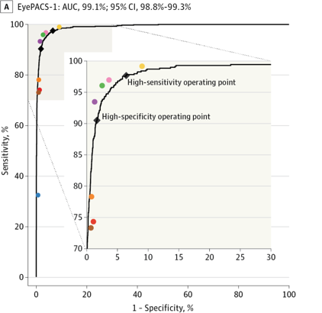
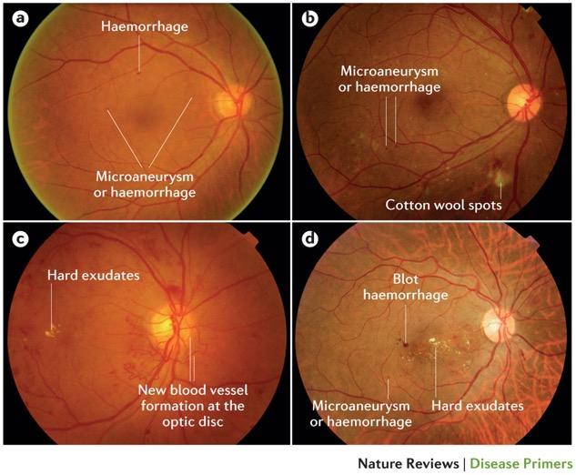
Retinopathy prediction from fundus images
colored dots are expert performance
Wong, T. Y. et al. (2016) Diabetic retinopathy
Nat. Rev. Dis. Primers doi:10.1038/nrdp.2016.12
Gulshan V, Peng L, Coram M, et al. Development and Validation of a Deep Learning Algorithm for Detection of Diabetic Retinopathy in Retinal Fundus Photographs. JAMA. 2016;316(22):2402–2410. doi:10.1001/jama.2016.17216
Notes:
But as before, we don’t really need to speculate about the value of information in images, or our ability to extract this information
Over the last few years, we’ve seen quite a few results showing that deep neural networks, if given a sufficiently large dataset to learn from -- are capable of analyzing medical images as well as – or in some cases, better than – trained specialists
Here we see the performance of a model that takes a fundoscopic image – that is, an image of the back of the eye – and predicts whether the patient has referrable diabetic retinopathy.
In this case, we see that the sensitivity and specificity of the model are on par with retina specialists
And similar findings have been observed in dermatology – a deep neural network was able to identify malignant skin lesions as well as trained dermatologists – as well as in pathology, radiology, etc
These results hold only for very specific scenarios and again, they also require large amounts of training data
Nevertheless, it’s very clear that there’s information in these images that you wouldn’t get from going over a patient’s previous medical history and other information previously captured in structured fields

Slide 17
A patient presents with shortness of breath…
Presents to urgent care and is transferred to the ED
Evaluated in the ED
History of present illness
Review of medical history (including meds and allergies) + social and family hx
Physical exam and review of systems
Lab results: BMP and CBC
Imaging & other studies: CT and EKG
Admitted to the hospital
Notes:
Now, going back to our snapshot once more, we do see that this patient had an EKG – an electrocardiogram

Slide 18
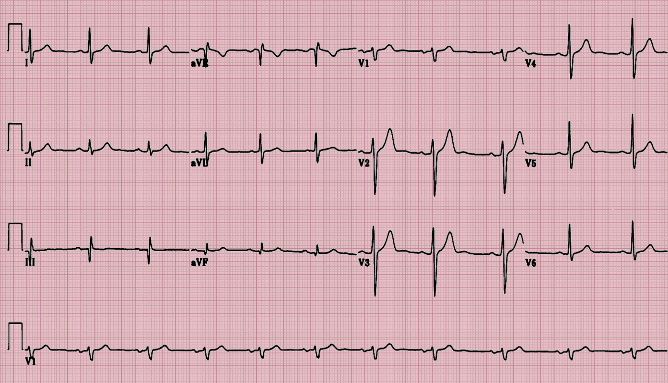
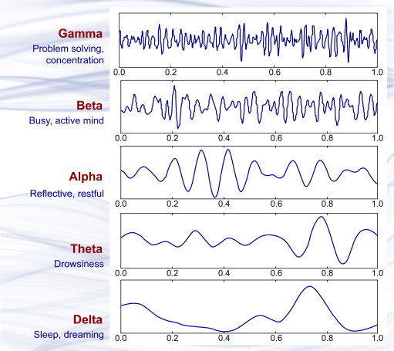
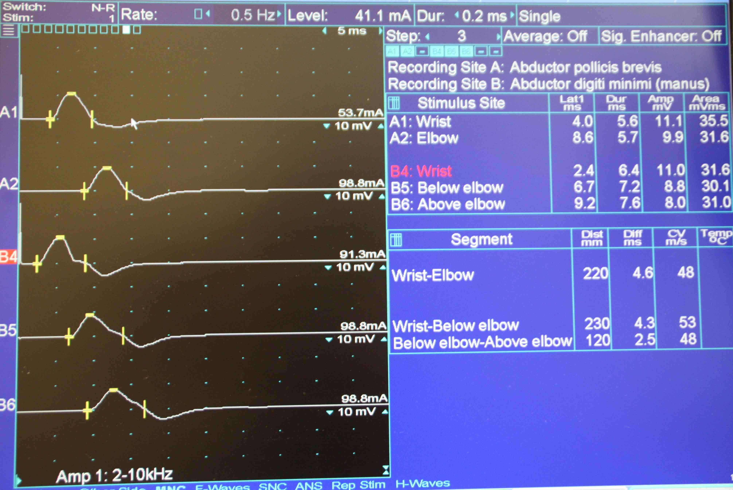
Electrophysiology
EKG (i.e. ECG)
EEG
EMG
Notes:
We’re going to focus less on electrophysiologic studies today, but suffice to say that an analogous argument holds for these data as well
Each of these studies generates a multi-dimensional physiologic time series that contains much more information than the resulting report
And in each case, the value of these data across a range of prediction tasks has been demonstrated in the biomedical literature. In fact, models for these data are fairly similar to the models that are used for image processing
I’m focusing even less on digital heatlh data in this lecture – that is, data captured by wearable devices and pertaining to the wearer’s physiology
But the same arguments hold for digital heatlh data, too, and we anticipate seeing these data integrated in EHR systems in the near future

Slide 19
Why use unstructured data?
Reason 1: it contains information not found in structured fields
clinial/domain knowledge helps gauge whether/when this info will be useful
example: use radiological images when predicting COPD prognosis
Reason 2: it may be available or useful outside of the EHR setting
example: predict malignancy from images of skin lesions
Reason 3: it is unaffected (or less affected) by provider decision-making
example: predict need for surgery from imaging of small bowel obstruction
Notes:
Before moving on to HOW we can use unstructured data, let’s take a last, quick, 10000 ft view of why this is a good idea
The first reason, and the one I’ve emphasized most here, is that these data contain information that’s not found in structured fields, yet is useful for a wide variety of analyses and prediction tasks
Now, the importance of that data compared to the structured data depends on the task, and knowing whether and when different data elements are likely to be important really depends on clinical knowledge
As a rule of thumb, it’s good to assume that these data MIGHT be important
So, when both structured and unstructured data are available, it often make sense to first build a simple model that uses structured data only
then see whether you get an improvement from adding an unstructured data modality that you hypothesize may be relevant. We’ll take a look at how to do that in just a moment.
But there are a couple other reasons we might use unstructured data
Reason 2 is that although we might be accessing the data through an EHR system initially, it might be possible to obtain similar data outside of an HER setting as well
If we find we can predict malignancy from images of skin lesions available in the HER, for example, we might ultimately aim to adapt and deploy the resulting model in a smartphone app
Finally, a third reason is that in some cases, we want to use unstructured, raw data exactly BECAUSE it has not been interpreted by a provider
Most structured data elements are affected by provider decision-making – if the provider things the patient has a PE, they’ll order different labs than if they think the patient had a heart attack
In most cases, this is helpful -- we want to take advantage of this information
But in other cases – prediction of referable diabetic retinopathy, going back to our earlier example – our goal is just the opposite – we want to see whether an algorithm can identify the condition WITHOUT the retina specialist’s interpretation
If that’s the case, we need to avoid structured elements that reflect provider decisions – and instead work only from that fundoscopic image

Slide 20
How do we use unstructured data (in isolation)?
Notes:
Alright. Let’s see how we can actually use unstructured data. First, we’ll think about how we can incorporate these data in prediction models just on their own -- in other words, we’re not yet combining them with structured data

Slide 21
In contrast to structured data…
Pro: Less manual data wrangling (important caveats apply…)
Con: Typically larger in size and more difficult to store / load / manage
Con: Modality-specific knowledge and steps are required to incorporate these data in predictive models
Notes:
Let’s set the stage with some pros and cons
Structured data, as you know, often require a lot of data wrangling
We have to deal with missing values, which differ from column to column
There might be outliers – these might be incorrectly entered values that we need to identify and remove
There might be formatting issues with our columns, and we might need to make sure the data type in each column is specified and interpreted correctly
Dealing with these things takes time, and these issues don’t really apply to unstructured data
Instead, we have a whole different set of headaches to deal with
One is that unstructured data tend to take up a lot of space.
On top requiring more storage, this means they’re slower to copy and move around
They’re slower to load
And, critically, usually your whole dataset won’t fit in memory at once
This means you have to be more thoughtful about how and when you load the data when training your models
Machine learning libraries have tools to help with this, but still, it can be a challenge that you’re much less likely to encounter for most structured datasets
The second big challenge is that you really need to have an understanding of the specific modality you’re working with
How it’s stored – different file formats, which is beyond the current scope
And which models are appropriate for a given modality – why they’re appropriate – and how they work.

Slide 22
Image Processing: Hierarchical Feature Extraction
low-level motifs
high-level motifs
dog
edges
shapes
textures
eyes
ears
paws
label
pixels
End goal: predict dog from pixels
Notes:
When working with images, you’ll need to use a deep neural network designed for image processing to extract predictive features from your images
Most often you’ll find that a kind of model called a convolutional neural network is used – this is what was used in all the image processing examples I’ve mentioned so far – but there are a few alternatives to this that are currently being explored in the research literature
Without going into the specifics, the big picture here is that these models work by learning a hierarchy of features that are relevant to a given prediction task
Let’s consider predicting whether a dog is present in the image above
The first thing you might notice is that a single pixel, in isolation – whether it’s bright or dark -- doesn’t tell you much about whether a dog is present
Instead of making predictions directly from a weighted average of pixels, the model first identifies simple patterns like edges, shapes, and textures – we call these low-level motifs
It then identifies patterns among the low level motifs – the edges, shapes, and textures combine to form more complex patterns
and these in turn combine to form even more complex, distinctive patterns like an eye, an ear, or a paw -- we call these high-level motifs
Finally, if the image contains an eye, an ear, and a paw in a specific arrangement, the model will predict dog; and if not, it’ll predict no dog

Slide 23
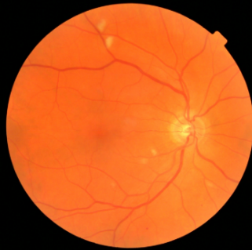
Image Processing: Hierarchical Feature Extraction
low-level motifs
high-level motifs
retinopathy
edges
shapes
textures
microaneurysm
exudates
hemorrhage
label
pixels
End goal: predict retinopathy from pixels
Notes:
Moving back to our medical example, we might want to detect referrable diabetic retinopathy
Just as before, the model does this by first detecting edges, shapes, and curves – the same thing it did when trying to identify a dog
But, at the next level, instead of looking for fur and whiskers, it will learn – from data – to identify blood vessels, exudates, hemorrhages, and so on
In labeling the high-level motifs as exudates and hemorrahges, I’m speculating to make the example more concrete
But, regardless of the specifics of those patterns, these models work by identifying increasingly complex patterns within each image
Depending on the degree to which various high-level patterns are present – again, we call these high-level motifs – the model will predict either retinopathy, or no retinopathy

Slide 24
To learn how these neural networks work:
Take my course (ML for Health in the CRTP)
Sign up for one of the AI Health winter or summer schools
For a more rigorous mathematical introduction, take a graduate level course in B&B or another department
Many online resources are available
Notes:
Really understanding the details here requires much more than we can cover in this lecture.

Slide 25
Image Encoder
CNN
Encoder
retinopathy
label
vector of features
(indicating high-level motifs)
image
Notes:
But the important thing to understand is that by applying a deep neural network to medical images
We can extract a set of numeric values that quantify the degree to which specific patterns – patterns that may be clinically relevant – are present in our images
We usually call these values a feature vector
And we can call this neural network an encoder
it takes our images and ENCODES them into a fairly small feature vector of say, 1000 or so values, which is much smaller than the number of pixels in our original image
Then, we can use a very simple model – usually logistic regression – to predict our outcome – in this case, retinopathy – from that feature vector
If we have enough data, we can use it to fine-tune our encoder to make sure it’s extracting the best, most predictive features possible
But, if we have less data, it’s often quite effective to simply apply an encoder that was shown to be effective for a different, ideally related medical image processing task

Slide 26
A typical prediction model
outcome
logistic
regression
label
vector of clinical variables
(e.g. age, sex, BP, HR)
Notes:
Let’s contrast all this with a simpler prediction task
Let’s say we have a vector of clinical variables for each patient in a study of long-term cardiovascular health, and from those variables we want to predict the probability of heart attack within the next 10 years
Here we can simply train a logistic regression model to predict the outcome directly from our variables, and then we might want to evaluate out-of-sample prediction performance

Slide 27
A prediction model for images
CNN
Encoder
outcome
logistic
regression
label
vector of features
(indicating high-level motifs)
image
Notes:
Now, imagine that instead of clinical variables, we instead had a fundoscopic image for each study participant.
Applying logistic regression directly to the pixels in the image isn’t going to work here.
Instead, we can apply an encoder – in this case, a convolutional neural network – to each image.
This will give us a feature vector that describes the degree to which 1000 or so complex patterns – patterns that are known to be important for other prediction tasks – are present in the image
We can then use logistic regression to predict the probability of heart attack from these feature vectors
As before, after training our logistic regression model, we’ll usually want to evaluate out-of-sample prediction performance
If we happen to have thousands of images, we can consider a more involved training process to fine-tune our CNN encoder to make sure the features we’re extracting are the best possible features for our prediction task
More often, we don’t have enough data to do this, so we just use the same encoder that was used in a different – hopefully somewhat related -- task

Slide 28
A note on the meaning(s) of “structured”
Most unstructured data are indexed by spatial location (images), time (time series), or position in a sequence (text)
We might call these data dependent
As a result, they have structure in the sense that measurements that are close together (in space, time, or position) tend to be correlated; and/or there may be characteristic spatial, temporal, or sequential patterns
Don’t get these two senses of the word “structured” confused!
Notes:
Now at this point, I'd like to pause for a moment to address a possible point of confusion regarding the word "structured"
important to distinguish between this meaning of structure and the one we've discussed in this lecture, which pertains to data organized into specific, queryable fields
OK, on to another very common variety of unstructured data…

Slide 29


NLP: Extraction of Word Counts
A spicy journey to an amazing future
Unlike anything we've seen in science fiction before
A smart science fiction film
[We’ve] seen too much of this sort of thing before
An effort to create a grand science fiction epic has yielded something cold
Dune (2020)
Reviews:
Notes:
Let’s think a little bit about how we can incorporate text data into a predictive model.
Let’s say we have a bunch of reviews of Dune, and we want to use logistic regression to predict whether they’re positive or negative
If you haven’t seen Dune, you’ll need to pause the lecture to go watch it before continuing
It’s important to note that although I’ve included two negative reviews to illustrate my points, in reality almost none of the reviews were negative
Now to use logistic regression, we first need to convert each review to a numeric vector

Slide 30
NLP: Extraction of Word Counts
A spicy journey to an amazing future
Unlike anything we've seen in science fiction before
A smart science fiction film
[We’ve] seen too much of this sort of thing before
An effort to create a grand science fiction epic has yielded something cold
1 | 1 | 1 | 1 | 0 | 0 | 0 | 0 | 0 | 0 | 0 | 0 | 0 | 0 | 0 | 0 | 0 | 0 | 0 | 0 | 0 | 0
0 | 0 | 0 | 0 | 1 | 1 | 1 | 1 | 1 | 1 | 0 | 0 | 0 | 0 | 0 | 0 | 0 | 0 | 0 | 0 | 0 | 0
spicy
journey
amazing
future
unlike
anything
seen
science
fiction
before
smart
film
much
sort
thing
effort
create
grand
epic
yielded
something
cold
0 | 0 | 0 | 0 | 0 | 0 | 0 | 1 | 1 | 0 | 1 | 1 | 0 | 0 | 0 | 0 | 0 | 0 | 0 | 0 | 0 | 0
0 | 0 | 0 | 0 | 0 | 0 | 0 | 0 | 0 | 1 | 0 | 0 | 1 | 1 | 1 | 0 | 0 | 0 | 0 | 0 | 0 | 0
0 | 0 | 0 | 0 | 0 | 0 | 0 | 1 | 1 | 0 | 0 | 0 | 0 | 0 | 0 | 1 | 1 | 1 | 1 | 1 | 1 | 1
Notes:
One very simple approach is to make a list of all the words that appear across all the reviews
Then count how many times each of those words appears in each review
So, we have variables corresponding to the words spicy, journey, and so on
And we represent the review “a smart science fiction film” as a vector with a 1 in the positions corresponding to a, smart, science, fiction, and film; and 0s in all other positions
There are a number of variations on this simple idea that turn out to be helpful
Note:
Sometimes we might count short phrases in addition to individual words
Sometimes we only count words that we already know are important – known medical terms, for instance
Sometimes we transform these counts based on how often each word occurs across all of the reviews
This simple approach is often surprisingly effective in practice

Slide 31
A prediction model for documents
NLP
Encoder
pulmonary embolism
logistic
regression
label
vector of features
(indicating word counts)
document
Notes:
To really understand all the nuances of how this is done, again I’d recommend an additional course in machine learning or natural language processing
But what’s important is that we have a process by which documents can be encoded as a feature vector
In our image processing example, the elements of this feature vector corresponded to high level motifs, or patterns, that might be present in the images
This time, the elements of this feature vector correspond to counts of words in a document
In both cases, at the end of the day we have a feature vector that we can use to predict an outcome of interest via logistic regression

Slide 32
NLP: Conversion to Word Vectors
Look up words individually to obtain their vectors
Construct a sequence of vectors
A spicy journey
A grid of numeric values;
similar to an image
Notes:
Again, the specific NLP encoder I mentioned – in essence, word counts – is often surprisingly effective
But, over the past 10 years, we’ve also learned how to convert words to vectors representing their semantic attributes
We call these “word vectors”, or ”word embeddings”
And they allow us to convert the sentence “a spicy journey” into a sequence of 3 vectors corresponding to ‘a’, ‘spicy’, and ‘journey’, respectively
Once we have a sentence in this format, we can apply a deep neural network model that extracts increasingly complex semantic motifs, similar to our image processing example

Slide 33
A prediction model for documents
NLP
Encoder
pulmonary embolism
logistic
regression
label
vector of features
(indicating document attributes)
document
Notes:
So, there are a few different types of natural language processing encoders one might consider for a given problem
But at the end of the day, each type takes a document or text passage as input and converts it to a feature vector that we can use to predict an outcome of interest via logistic regression or another simple model

Slide 34
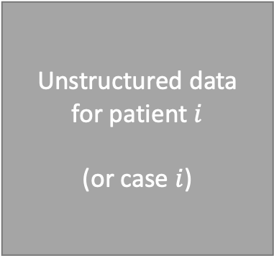
A prediction model for unstructured data
Unstructured data
for patient $i$
(or case $i$)
Modality-Specific
Encoder
outcome
logistic
regression
label
data
vector of features
Notes:
This is the important, general principle to understand
The details of the encoder are going to be modality-specific and potentially complex
But, the general rule when working with unstructured data is that you’ll need to identify and use encoders appropriate for each modality
If you’re working with EEG data, you’ll need an encoder designed for EEG data
If you’re working with digital health data, you’ll need an encoder designed for digital health data
Currently, many of the most effective encoders are neural network based, but this is not necessarily or always the case

Slide 35
How do we use unstructured data together with structured data?
Notes:
This idea of modality-specific encoders is quite useful, and makes it easy to see how we can combine unstructured data with structured data in our prediction models

Slide 36
Separate Prediction Models
outcome
logistic
regression
clinical variables
CNN
Encoder
outcome
logistic
regression
image
image features
NLP
Encoder
outcome
logistic
regression
document
document features
Notes:
Consider predicting the same outcome with (a) clinical variables, (b) a relevant image, or (c) a text document
With the clinical variables, we can use logistic regression – or whatever generalized linear model is appropriate for our outcome – to predict the outcome directly
With the image, we can use a convolutional neural network to encode the image as a feature vector, then use a generalized linear model to predict the outcome from that feature vector
Wtih the document, we can use an NLP encoder, which might be counts-based, or it might be word vector based, to encode the image into document features, then use a generalized linear model to predict the outcome from that feature vector

Slide 37
Multi-Modal Prediction Model
CNN
Encoder
outcome
logistic
regression
image
NLP
Encoder
concatenated, multi-modal features
document
Notes:
But what if we want to make predictions from all three types of data, together?
As this diagram suggests, we can approach this by simply concatenating – in other words stacking – all of our feature vectors together. We can combine our clinical variables with our extracted image features and extracted NLP features.
Of course, this is the obvious thing to do once you understand the concept of an encoder, but having effective encoders for some of these data types – notably image data – is still a fairly recent development

Slide 38
Multi-Modal Prediction Model
Train independently
Concatenate
Train together
CNN
Encoder
outcome
logistic
regression
image
NLP
Encoder
concatenated, multi-modal features
document
Notes:
So, when developing a prediction model that uses multiple modalities
In general you want to follow these three steps.
First, train separate models for each modality using appropriate, modality-specific encoders.
This provides an opportunity to make sure your encoders are working, potentially refine them, and determine whether each modality contains information predictive of the outcome
Then, concatenate your feature vectors together and use the concatenated vector as the input to a single generalized linear model

Slide 39
Multi-Modal Prediction Model
Train independently
Concatenate
Consider adding one more fully-connected, “interaction” layer
Train together
Fine-tune the whole model
CNN
Encoder
outcome
logistic
regression
image
NLP
Encoder
concatenated, multi-modal features
document
Notes:
As a slightly more advanced version of this, you may want to use a neural network with a single hidden layer to make predictions from your concatenated feature vector rather than a generalized linear model.
This allows you to take advantage of interactions between modalities that may be present
Finally, as a second optional step, you can fine-tune your entire model – including each modality specific encoder – together using a machine learning library like pytorch or tensorflow
This last step will be challenging from a data management and computational perspective, and it will not always improve performance, which is why I say it is optional.

Slide 40
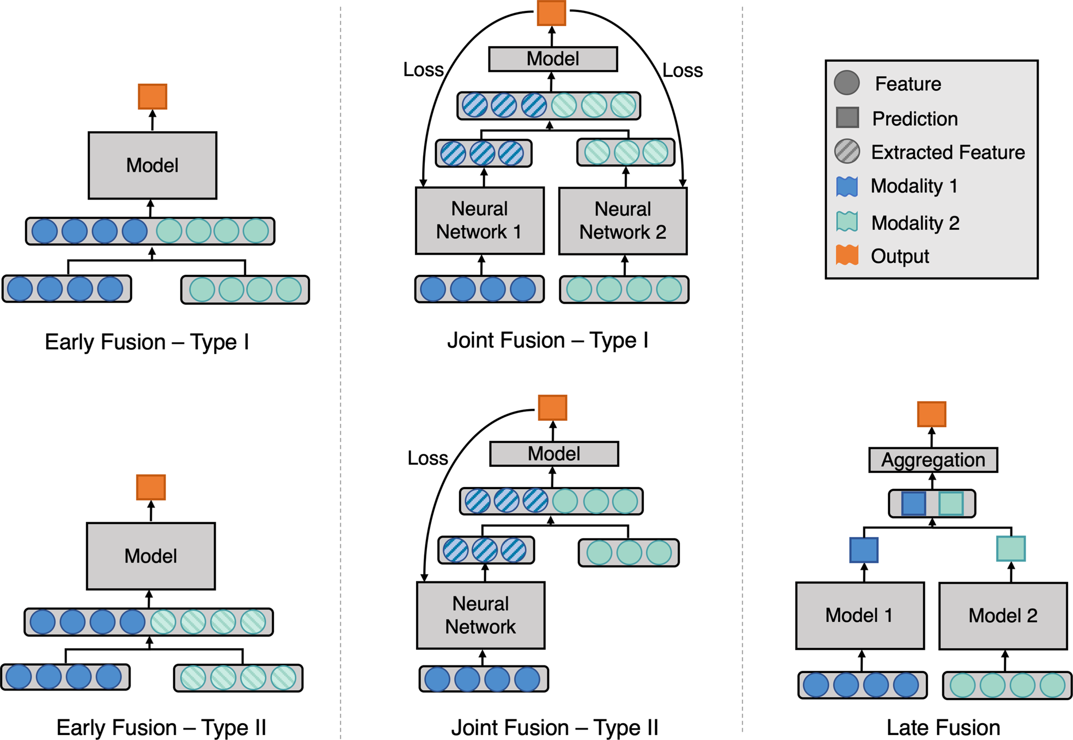
Variations on Multi-Modal Fusion
Huang, SC., Pareek, A., Seyyedi, S. et al. Fusion of medical imaging and electronic health records using deep learning: a systematic review and implementation guidelines. npj Digit. Med. 3, 136 (2020).
Notes:
This approach is sometimes called “joint fusion”, and consistently performs better than the alternatives, as shown in the npj digital medicine paper cited here
One alternative they explored, called early fusion, involves concatenating raw data together across all modalities without first applying modality-specific encoders, and in general it performs poorly
Another alternative, called late fusion, aggregates predictions across all modalities. In late fusion, instead of concatenating feature vectors together, we would take the predictions of multiple, modality-specific models and combine them, for example by averaging, into a single prediction.
Late fusion is appropriate in some contexts and can be easier to implement, but in general is not as effective as joint fusion.

Slide 41
Conclusions
Multi-modal data is common in healthcare
Unstructured data often contains information not captured in structured fields that is important to a given prediction task
Unstructured data modalities include images, clinical notes, physiologic time series, and more
In general, each modality requires an encoder specific to that modality to extract features useful for prediction
To incorporate multiple modalities (e.g. structured data + images + notes) in a single prediction model, we typically concatenate high-level features associated with each modality. This is known as joint fusion, and it performs much better than the naïve approach of concatenating all of the raw data together in a single vector.
Notes:
In conclusion

Slide 42
Thank you!
Be in touch -> m.engelhard@duke.edu
Notes:
Thanks very much for listening, and please don’t hesitate to get in touch with questions or ideas.

